Slide 1
Garbage Monitoring System
Gopal Thapa Magar

Slide 2
Introduction
The garbage monitoring system notifies a user when garbage is about to be full in a dustbin by measuring garbage level in the dustbin. It helps people to give heads up when the garbage level is high.
It detects garbage level
Notify user

Slide 3
Aim and Objectives
Aim
To help people to know the garbage bin is about to be full through notification
Objectives
To help people to give heads up about garbage level
Help people to save their time
Helps people not to check the dustbin frequently.

Slide 4
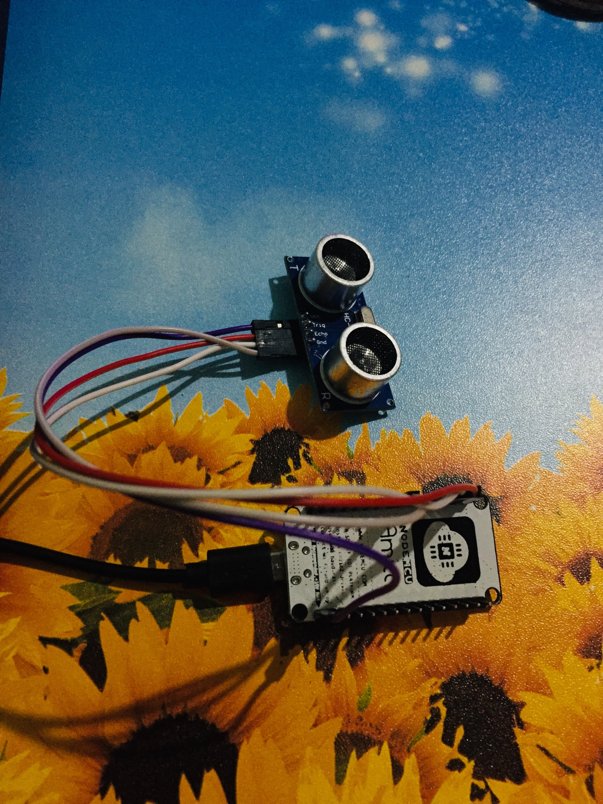
Hardware
Nodemcu
Ultrasonic sensor
Type B cable

Slide 5
Software and library
Arduino IDE
Blynk app
Library ESP8266WiFi
Library BlynkSimpleEsp8266

Slide 6
Working Process
Measure garbage level through ultrasonic sensor
Compare with define garbage level
If equal or less, then notify user if not keep measuring.

Slide 7
Benefits
Helps people to know if the garbage bin is about to be full
Helps to save time
Limitation
Can't tell the location of the garbage
Can’t identify whether garbage is disposable or not
Future Work
Can integrate GPS tracker to send the location of dustbin
We can use the sensor to find out which dustbin to dump garbage based on where they are disposable or not

Slide 8
Thank You

